Slide 1

DunDeal
Yuri Khechoyan, Leah Perry, Jessie Wilkins

Slide 2
Team Information
Yuri Khechoyan
Major(s): Bus. Admin & MIS
Year: Junior
Role: Project Lead, SW Engineer, UI/UX Designer, Software Developer

Slide 3
Team Information
Leah Perry
Major(s): Cyber Security
Year: Senior
Role: UI/UX Designer, Software Developer

Slide 4
Team Information
Jessie Wilkins
Major(s): MIS | Cyber Security (minor)
Year: Sophomore
Role: UI/UX Designer, Firebase Engineer, Software Developer

Slide 5


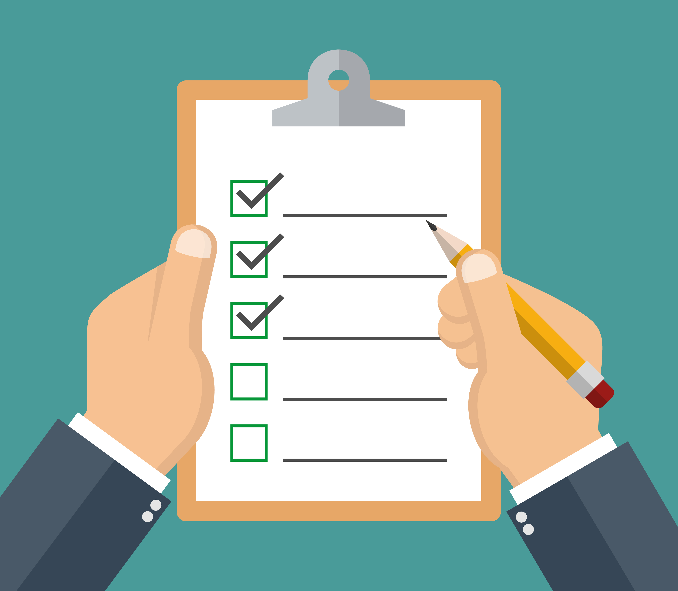
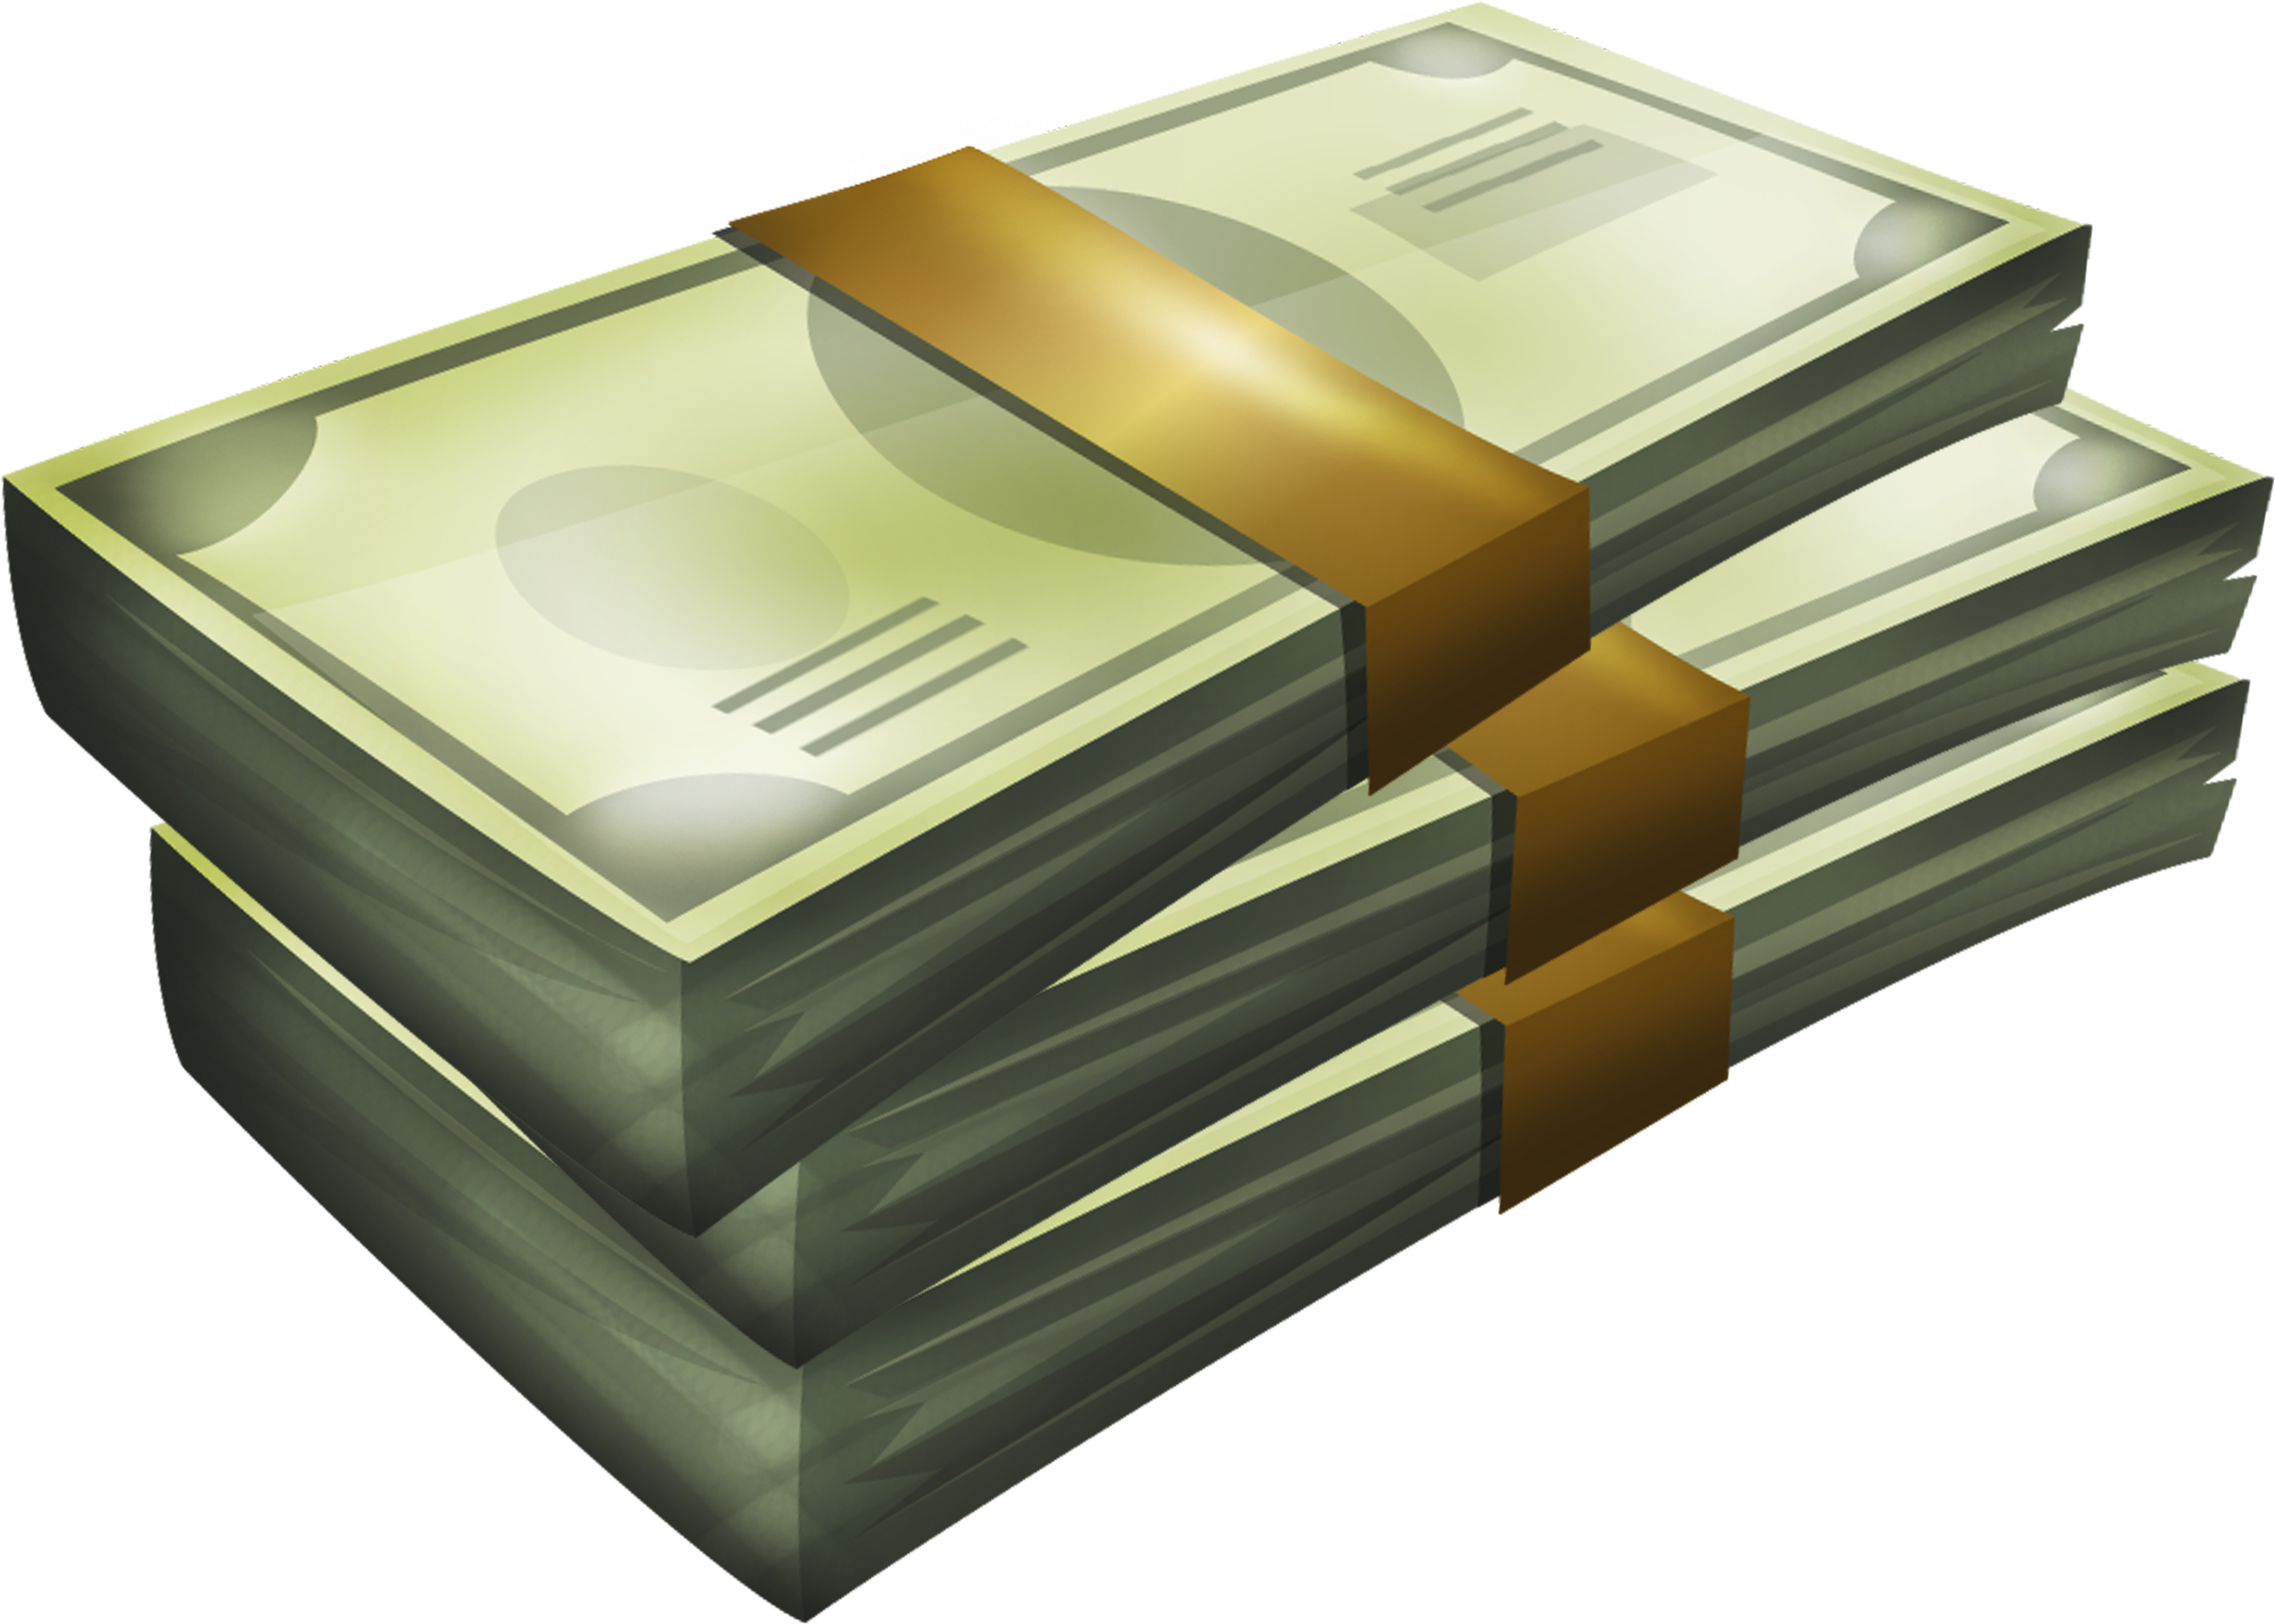
Purpose & Goal
Create service based App
Help College Students w/tasks
Get Paid – Students & Us
Similar: Uber & UberEATS

Slide 6


Major Features
Students (Task Completers) – called Dundies (contractors)
Dundie accepts task: Student (task creator) is notified thru app who is taking care of task
Uses Google’s Firebase System to communicate info between Student & Dundie

Slide 7
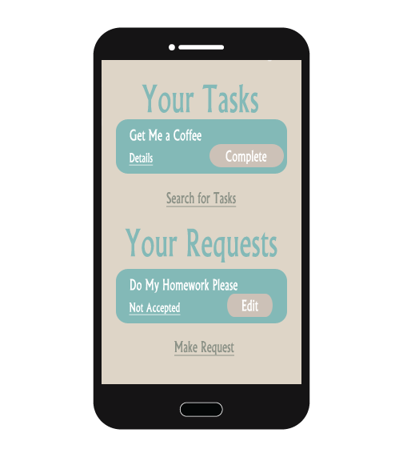
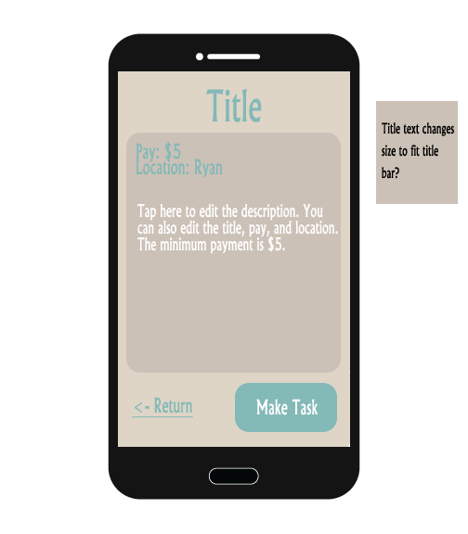
Mock-ups
Main Menu
Create Task

Slide 8
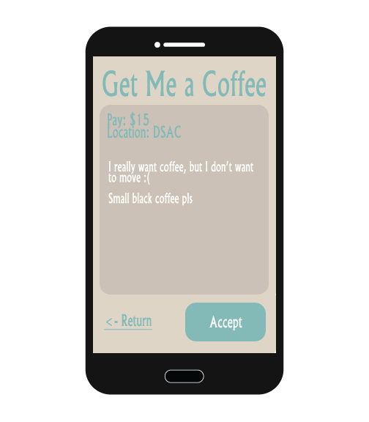
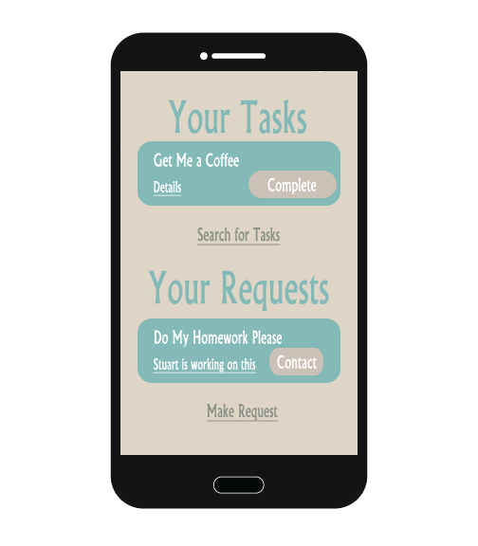
Mock-ups
Accept Task (Dundie)
Task In
Progress

Slide 9
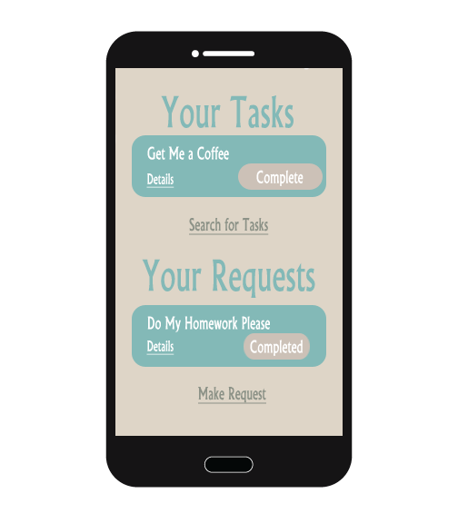
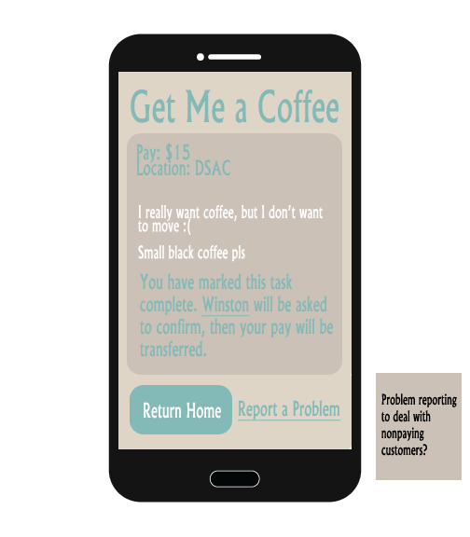
Mock-ups
Task officially completed by Dundie (main menu view)
Dundie: Completed Task (When Details button is pressed)

Slide 10
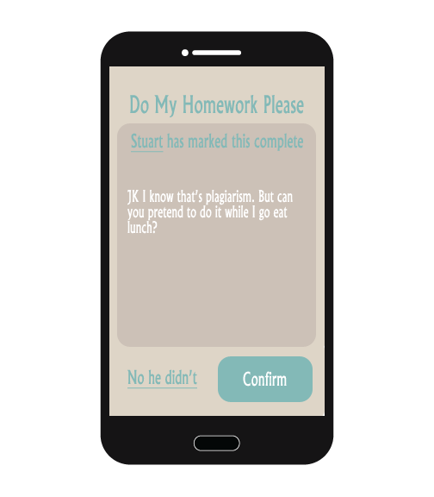
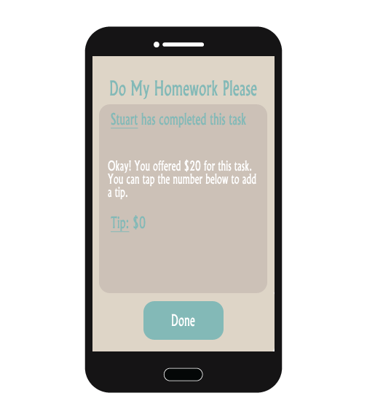
Mock-ups
Student: Confirm/Deny task completion
(Confirm button pressed) Add Tips [optional]

Slide 11
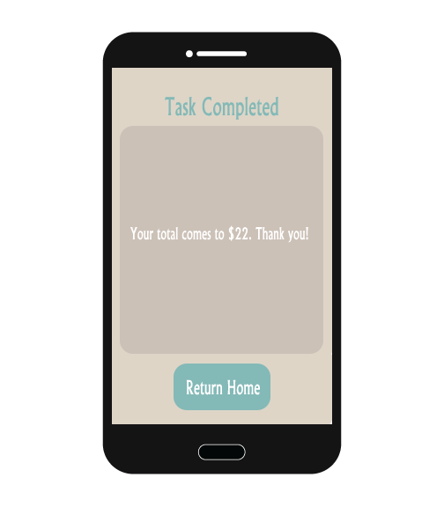
Mock-ups
Student: Confirmation (Done button is pressed)

Slide 12
Lesson Learned
Team Collaboration: Everyone has a strength & weakness
GitHub = Life Saver:
git reset [commit number] --hard
git push origin -f
App communicates with Firebase

Slide 13
Live Demo

Slide 14
Conclusion
Questions?

